Slide 1
Regression: OLS
Math Camp 2020
James Steur

Slide 2
Goals of the Session
Review basics of matrices
Understand notation of linear algebra and linear regression
Develop intuition about linear regression (OLS)
Understand assumptions of linear regression (OLS)

Slide 3
Review Matrices
Linear Regression with Ordinary Least Squares (OLS) relies on matrix algebra.
The math and concept behind OLS is easier to understand with matrix algebra.

Slide 4
What is a matrix?
Not the picture to the right
In your own words, what is a matrix?

Slide 5
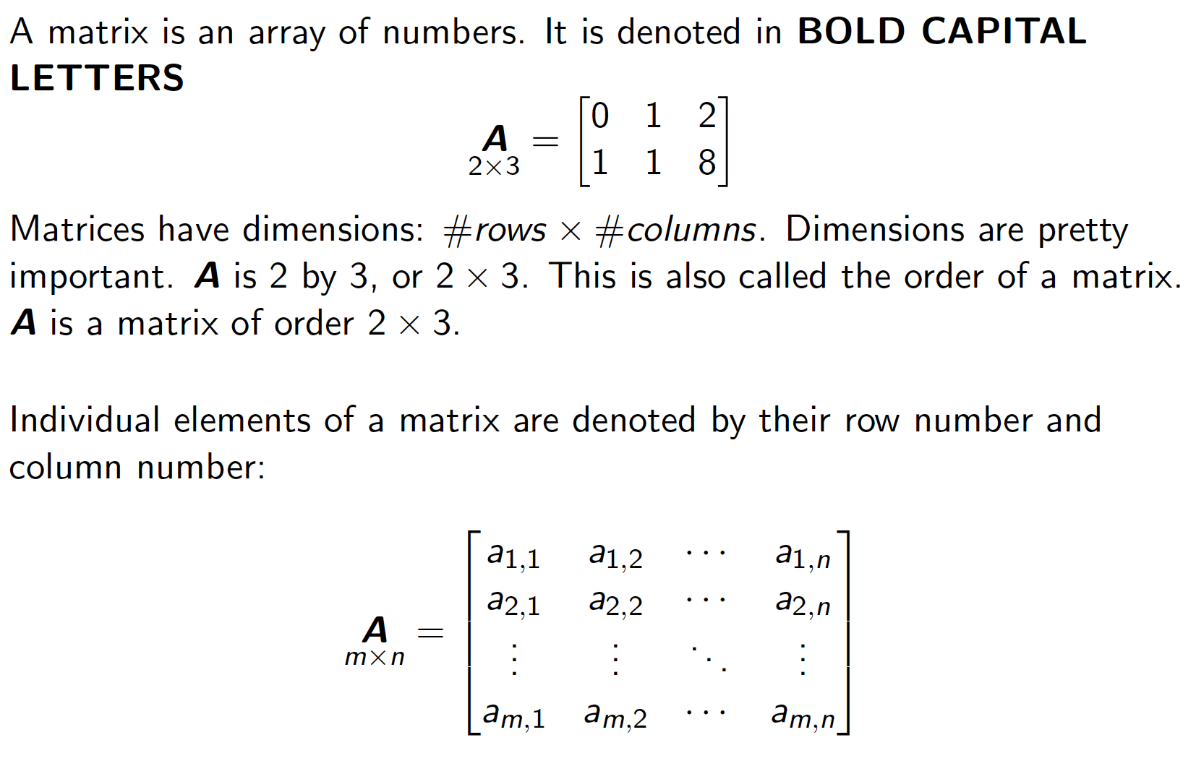
Basics of Matrices: Notation

Slide 6
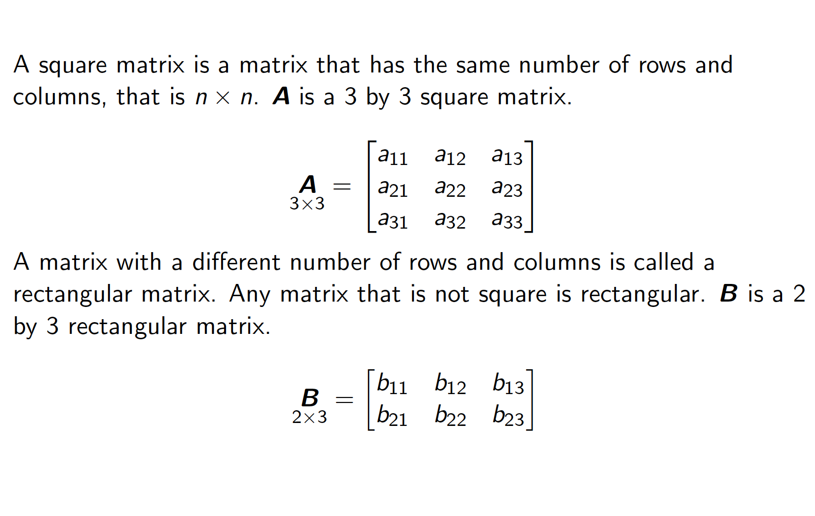
Square & Rectangle

Slide 7
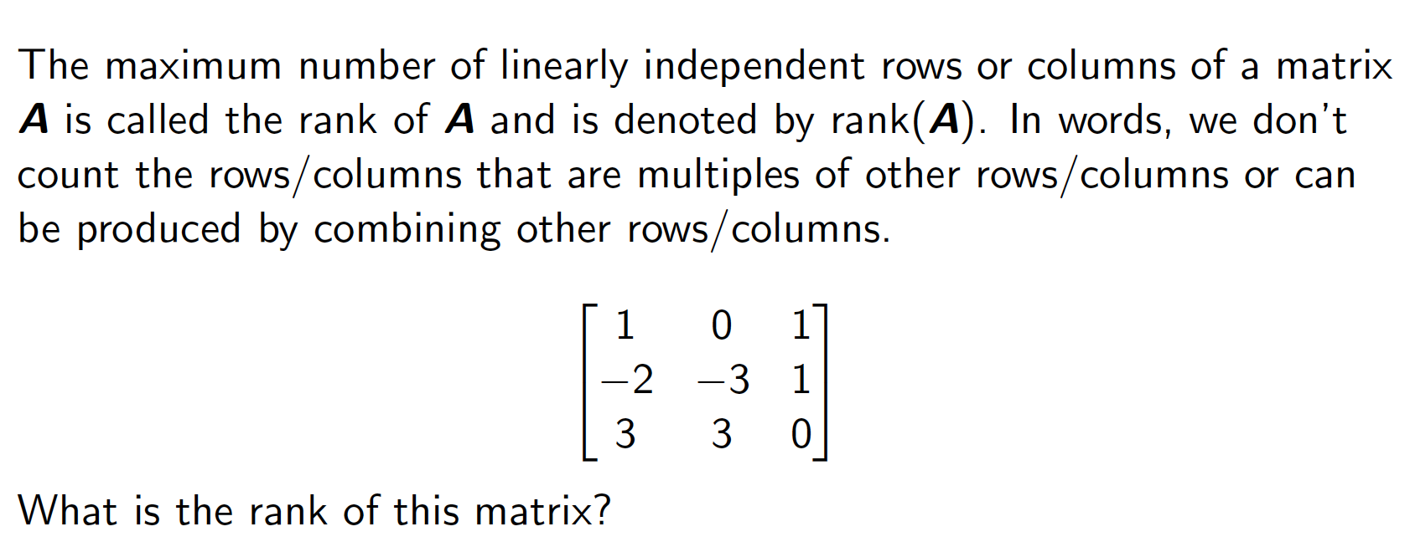
Rank

Slide 8
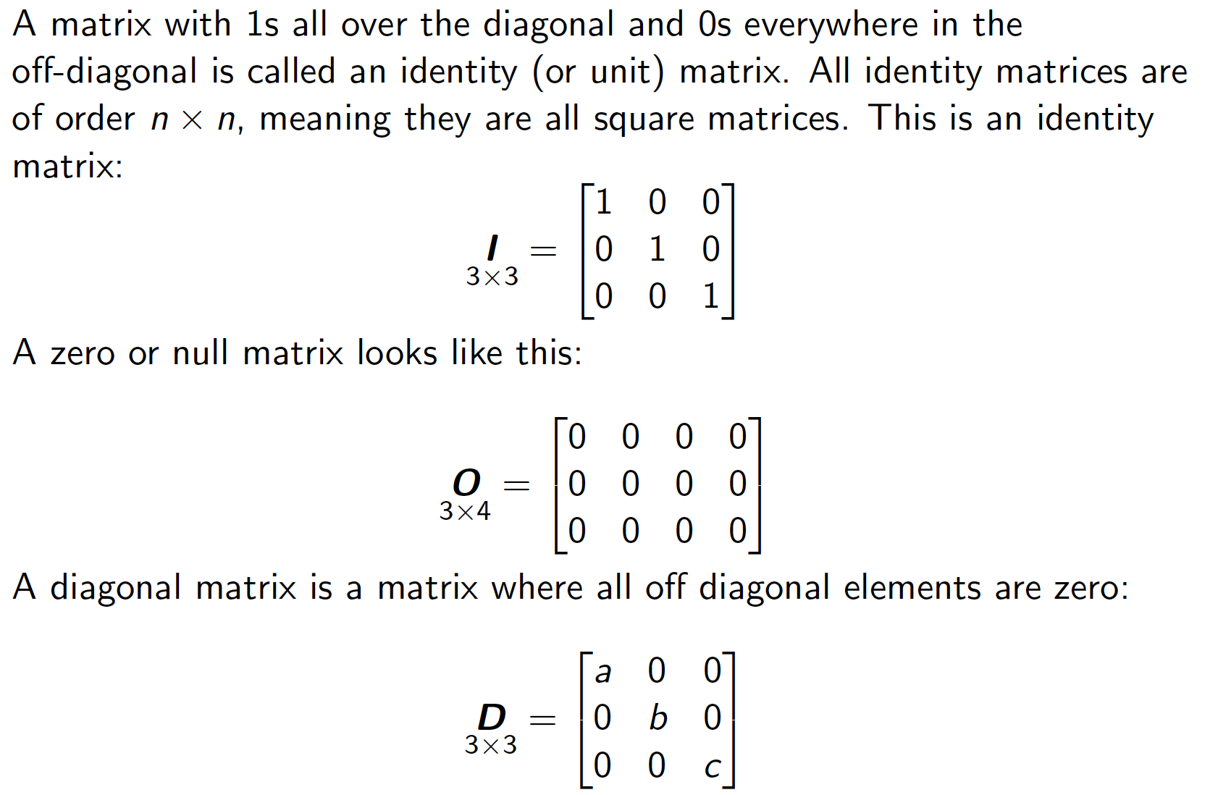
Identity Matrix

Slide 9
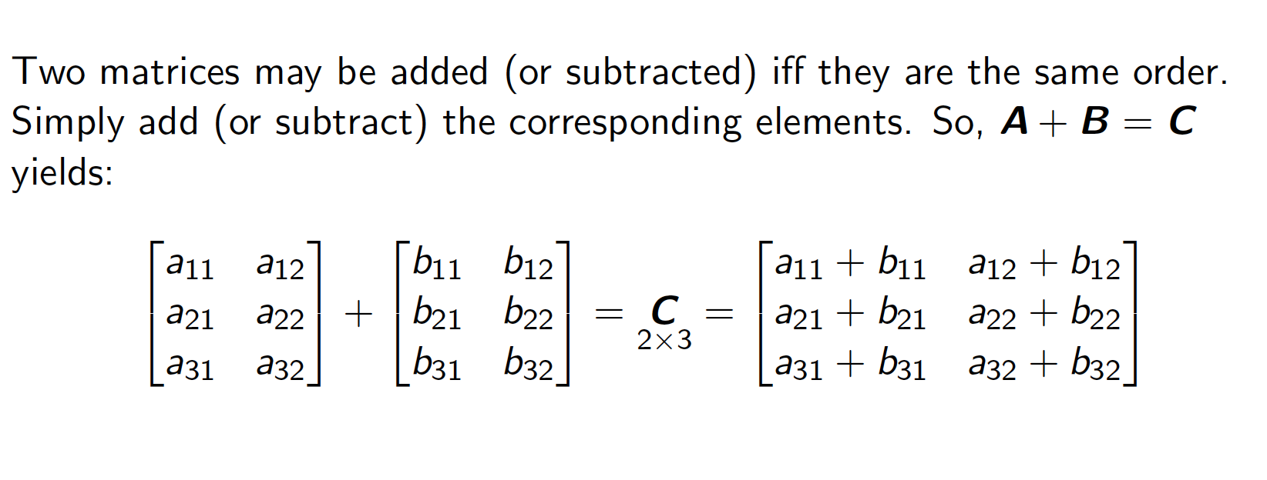
Addition & Subtraction

Slide 10
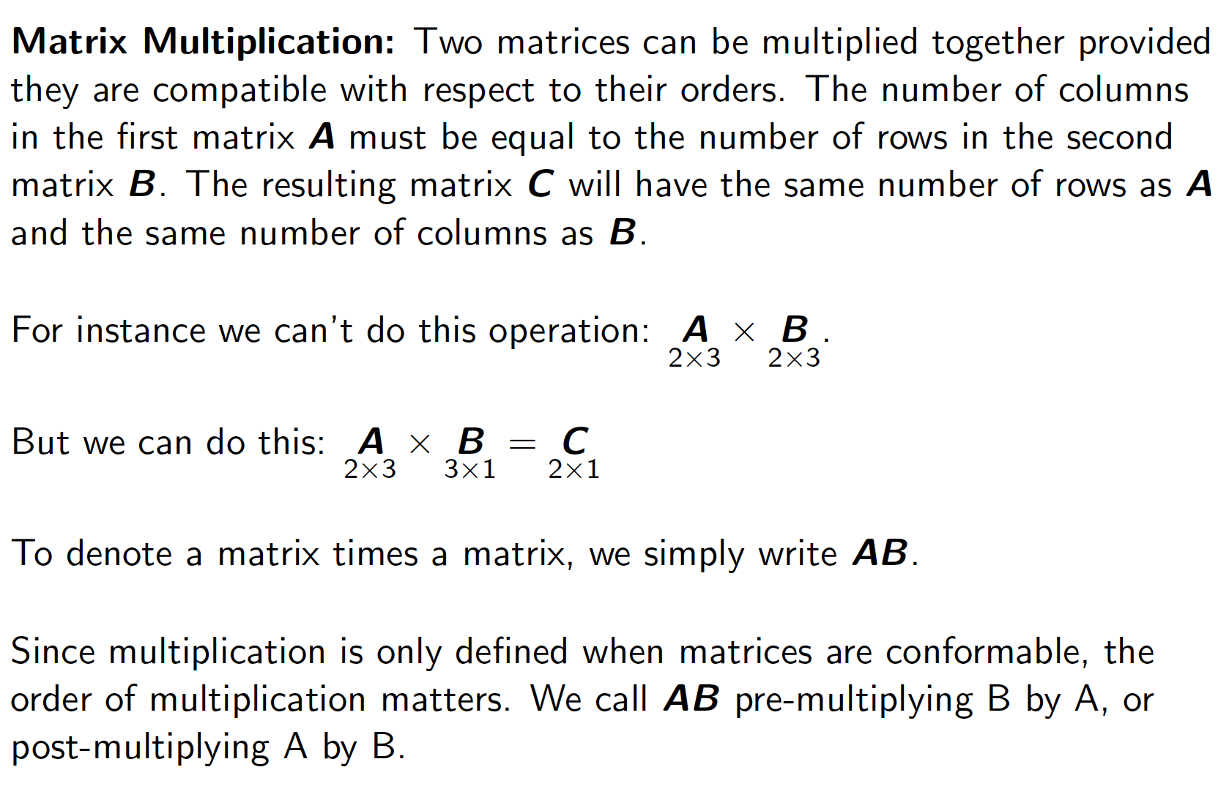
Multiplication

Slide 11
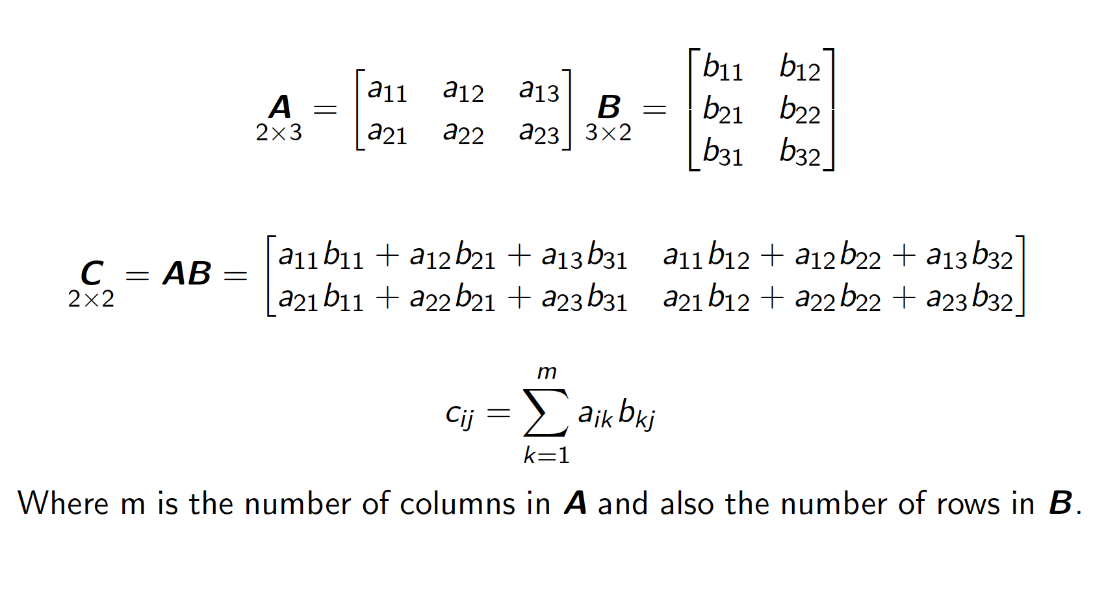
Matrix Multiplication

Slide 12
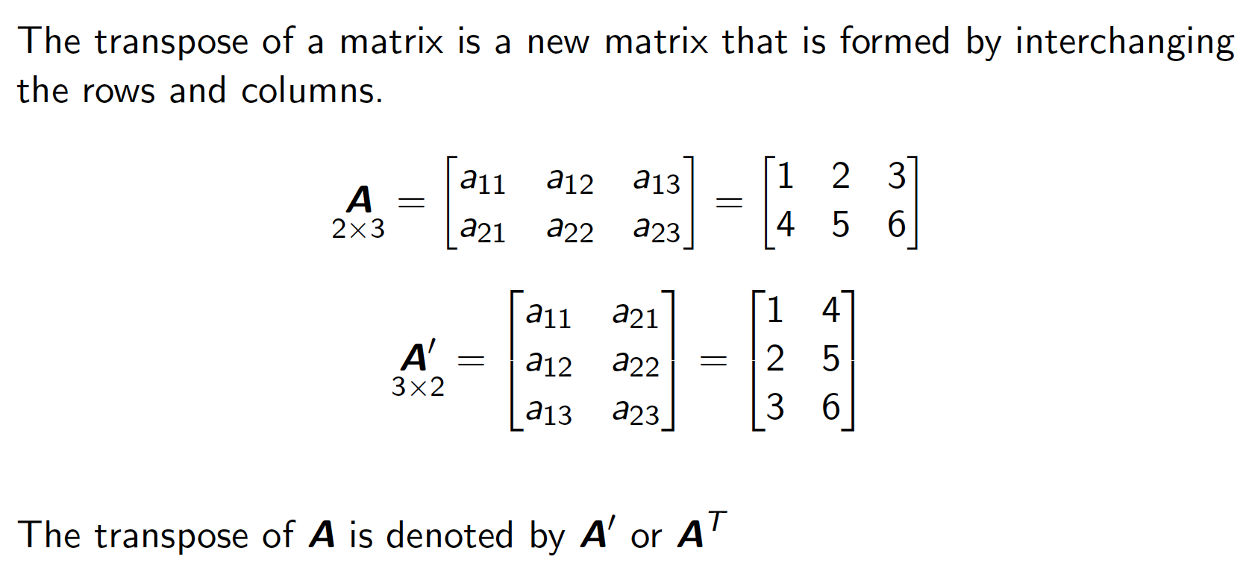
Transposition

Slide 13
Basics of Regression
Each blue dot is a datum point
We want to imagine a line that, on average, captures the association between our x and y value.
This line is the “line of best fit” or a regression.

Slide 14
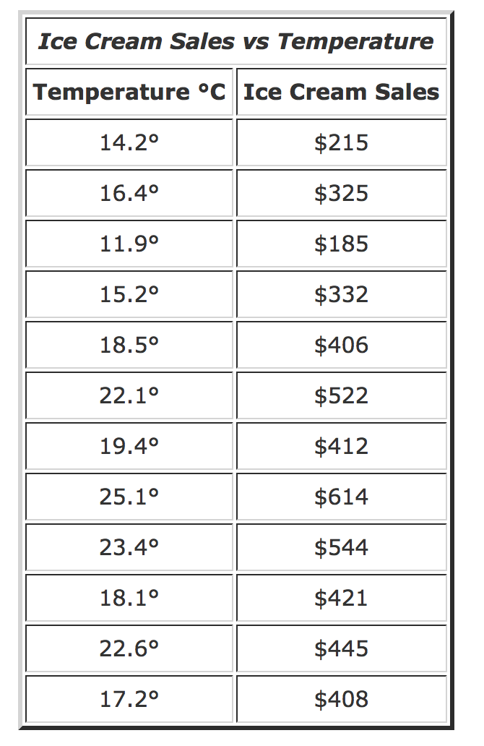
Data

Slide 15
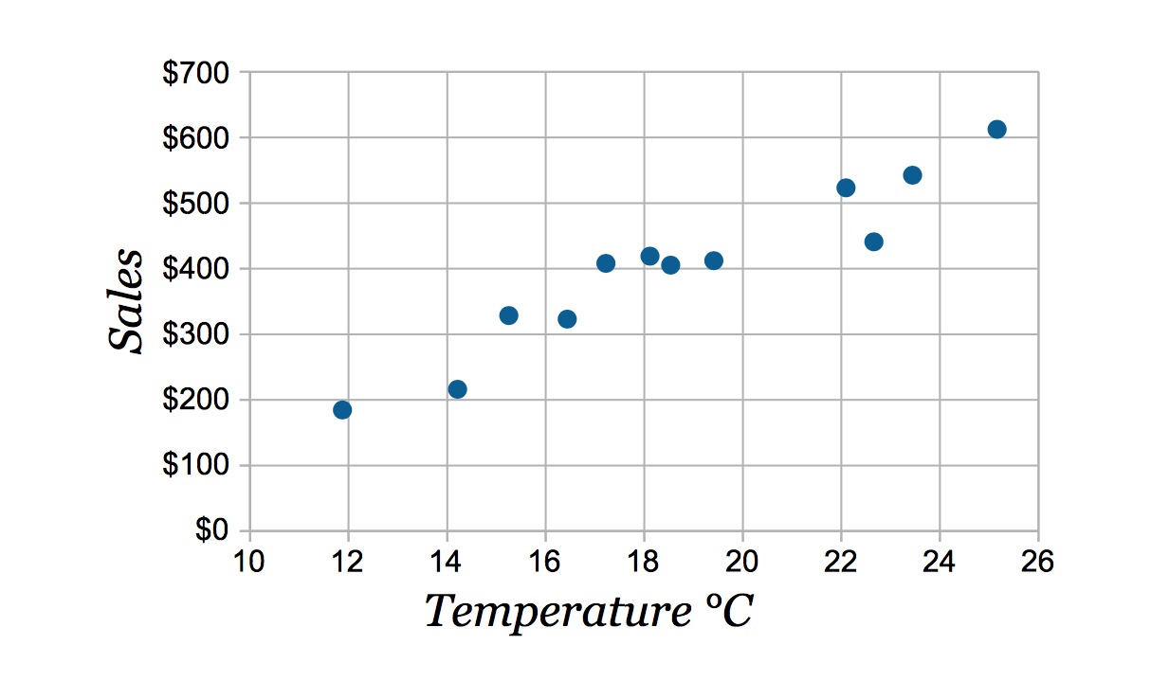
Scatterplot
Ice Cream Sales on Californian Beach in 2017
In your own words, what is a scatterplot?

Slide 16
How do we represent the relationship between ice cream sales and temperature?
Ice Cream Sales on Californian beach in 2017

Slide 17
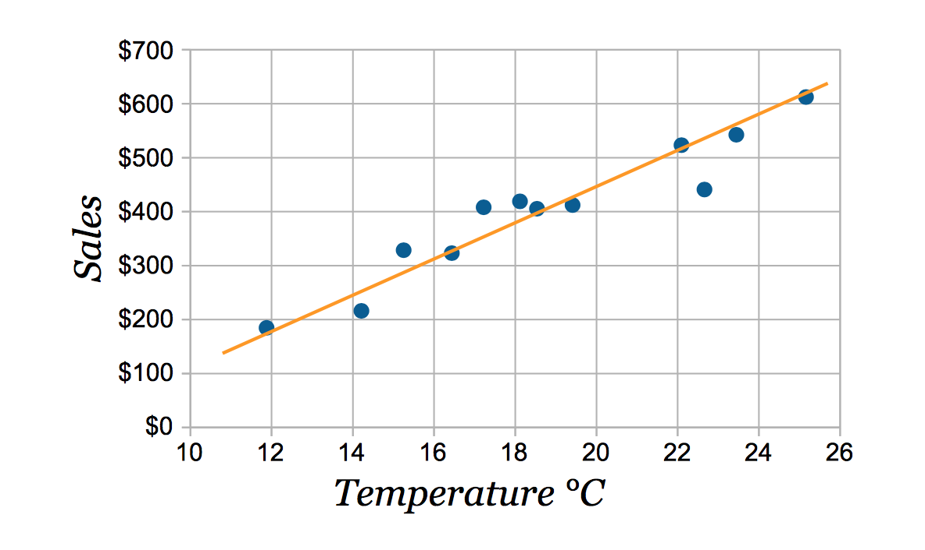
A line

Slide 18
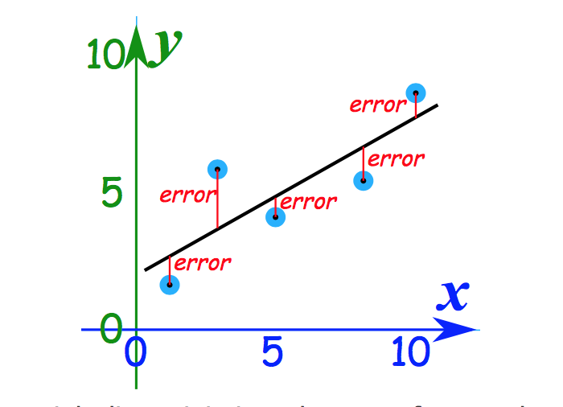

Slide 19
My Claim
To understand data, you “play” with data.
Scatterplots and regression are important to understand data.
Therefore, you need to understand regression.

Slide 20
Matrices are Great for Representing Data

Slide 21
Think About What Data Tells Us
1). IV: Sex. DV: Liberalness
2). IV: Years of Education. DV: Liberalness

Slide 22
Pop Quiz
What is a scalar?
What is a vector?

Slide 23
Pop Quiz
What is a matrix?
What is rank?

Slide 24
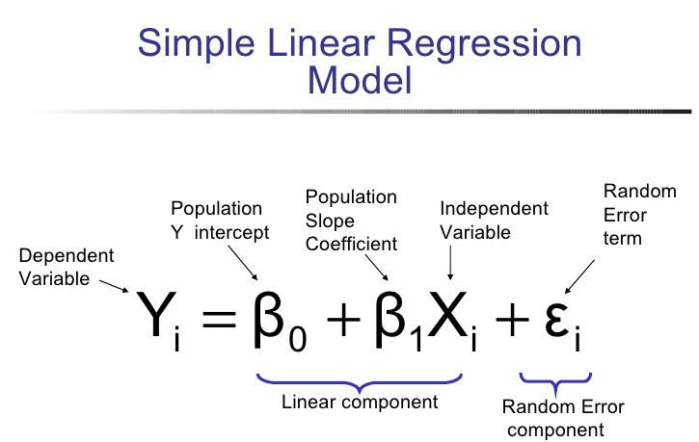
Simple Linear Regression Notation

Slide 26
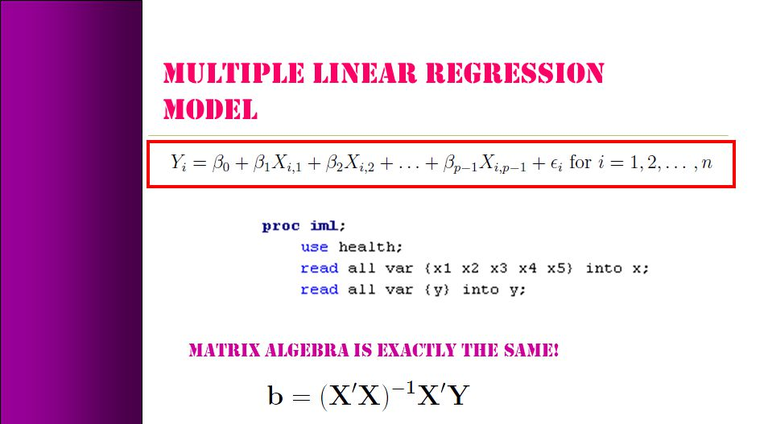
Linear Algebra

Slide 27

Regression Notation
Y = ${\text{β}}_{0}$ + Xβ + ε.
Y=Dependent Variable
${\text{β}}_{0}$=Intercept
X=Independent Variable
Β=Vector of regression coefficients
ε=Error Term

Slide 28

Pop Quiz
We have the following equation: Y = ${\text{β}}_{0}$ + Xβ + ε.
What does “Y” mean?
What does “${\text{β}}_{0}$” mean?
What does “ε” mean?
What does “Xβ” mean?

Slide 29
Assumptions of Regression
Numerical Properties 1. For our OLS algorithm to work, we need variance in X, so var(X) ≠ 0.
2. When we get to multiple regression, we’ll see that we cannot estimate a model with as many or more independent variables than we have data points. We cannot estimate a simple regression with only data point. There are many ways to state this assumption. After we introduce some matrix algebra and think of X as a matrix (with independent variables for columns and observations for rows), we’ll always state it as a restriction about the matrix X.
3. Y and X are linearly related, in particular by the model specification: Y = β0 + β1X + ε

Slide 30
Assumptions of Regression Continued
Statistical Properties
3. The population residuals, ε, are IID, with mean 0 and variance σ2. (Note that this is a statement about random variables, not about sample data)
4a. X is fixed (nonstochastic) and all of our estimates are conditional on X; OR
4b. X is random, and population residuals are independent of X.
4 confuses everyone (at first), and many books make assumption 4a but do not write the conditions explicitly, e.g. E(εi|Xi)=0.

Slide 31
More Assumptions Restated
1. Linear model, Yi = β1+β2Xi + ui 2. X values fixed in repeated sampling 3. Zero mean value of disturbance, E(ui |Xi) = 0 4. Homoscedasticity, var(ui |Xi) = σ2 5. No autocorrelation, cov(ui,uk|Xi,Xk) = 0 6. Cov(ui,Xi) = 0 7. N (observations) > k (parameters) 8. Var(Xi)>0 9. Correct specification 10. No perfect multicollinearity between independent variables

Slide 32
Pop Quiz
What are two assumptions of regression?

Slide 33
Takeaways
Why we care about linear algebra
Intuition & basics behind regression
Assumptions of regression (OLS)
Basics of matrices

Slide 34
References
Mathisfun.org
Gaines, Brian. Matrix Algebra. (Quant I Materials.)
Basar, Ekrem. Matrix Algebra. (Quant II Methods TA Presentation.)
Kim, Sanghoon. Matrix Algebra. (Math Camp Presentation 2019.)

